Slide 1
The Fiction of C. S. Lewis
Heaven and Hell

Slide 2
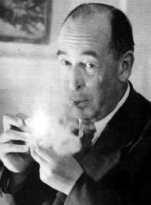
Clive Staples Lewis (1898-1963)

Slide 3
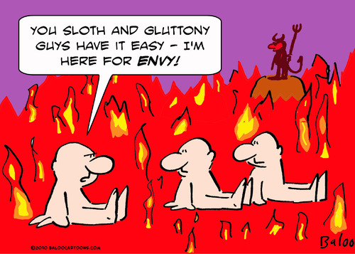
Images of Hell

Slide 4
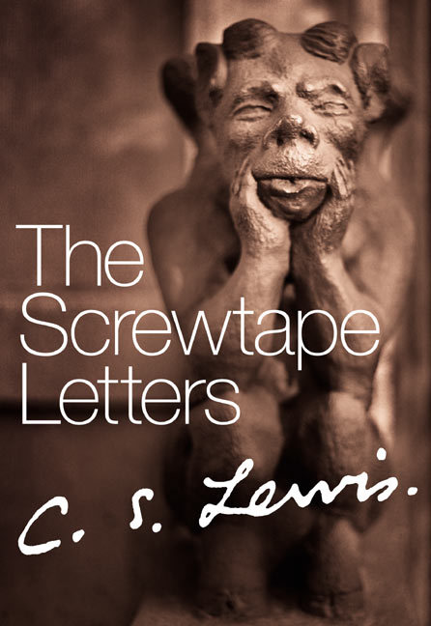
1940

Slide 5
Devouring and Possession
“Our war aim is a world in which Our Father Below has drawn all other beings into himself: the Enemy wants a world full of beings united to him but still distinct.” P. 207
“The whole philosophy of Hell rests on recognition of the axiom that one thing is not another thing, and, specially, that one self is not another self. My good is my good and your good is yours. What one gains another loses.” P. 236
“…either Our Father or the Enemy will say ‘Mine’ of each thing that exists, and specially of each man.” P. 247

Slide 6
The Gentle Road to Hell
“The Christians describe the Enemy as one ‘without whom Nothing is strong’. And Nothing is very strong: strong enough to steal away a man’s best years not in sweet sins but in a dreary flickering of the mind over it knows not what and knows not why, in the gratification of curiosities so feeble that the man is only half aware of them, in drumming of fingers and kicking of heels, in whistling tunes that he does not like, or in the long dim labyrinth of reveries that have not even lust or ambition to give them a relish, but which, once chance association has started them, the creature is too weak and fuddled to shake off. …It does not matter how small the sins are provided that their cumulative effect is to edge the man away from the Light and out into the Nothing. Murder is no better than cards if cards can do the trick. Indeed the safest road to Hell is the gradual one—the gentle slope, soft underfoot, without sudden turnings, without milestones, without signposts…” P. 219-220

Slide 7
Of Death
“Just think (and let it be the beginning of your agony) what he felt at that moment; as if a scab had fallen from an old sore, as if he were emerging from a hideous, shell-like tetter, as if he shuffled off for good and all a defiled, wet, clinging garment. By Hell, it is misery enough to see them in their mortal days taking off dirtied and uncomfortable clothes and splashing in hot water and giving little grunts of pleasure—stretching their eased limbs. What, then, of this final stripping, this complete cleansing?” (p. 275)

Slide 8
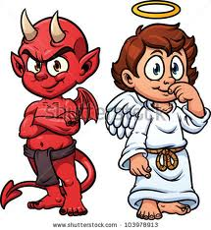
“Two Equal and Opposite Errors”

Slide 9
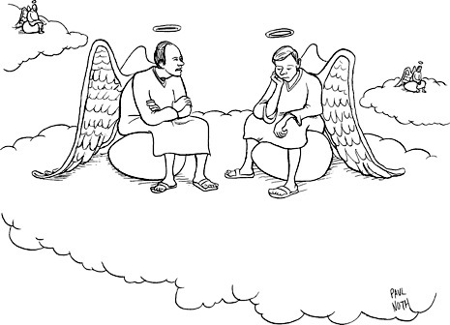
Images of Heaven

Slide 10

1945

Slide 11
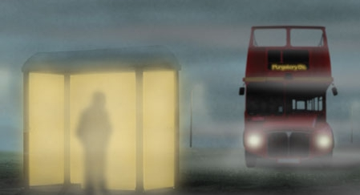

Slide 12
Hell Acc. to Lewis
Smallness: “…a damned soul is nearly nothing: it is shrunk, shut up in itself. Good beats upon the damned incessantly as sound waves beat on the ears of the deaf, but they cannot receive it. Their fists are clenched, their teeth are clenched, their eyes fast shut. First they will not, in the end they cannot, open their hands for gifts, or their mouth for food, or their eyes to see….Only One has descended into Hell.” P. 538
“Milton was right. The choice of every lost soul can be expressed in the words, ‘Better to reign in Hell than to serve in Heaven.’” P. 504
“There are only two kinds of people in the end: those who say to God, ‘Thy will be done, ‘ and those to whom God says, in the end, ‘Thy will be done.’ All that are in Hell, choose it. Without that self-choice there could be no Hell. No soul that seriously and constantly desires joy will ever miss it. Those who seek find. To those who knock it is opened.” P. 506

Slide 13

Heaven is a Wonderful Place

Slide 14
Heaven and Hell in Abstraction?
“Hell is a state of mind—ye never said a truer word. And every state of mind, left to itself, every shutting up of the creature within the dungeon of its own mind—is, in the end, Hell. But Heaven is not a state of mind. Heaven is reality itself. All that is fully real is Heavenly. For that can be shaken will be shaken and only the unshakeable remains.” P. 504

Slide 15
The Marriage of Heaven and Hell?
“Our light can swallow up your darkness: but your darkness cannot now infect our light.” P. 535
“The demand of the loveless and the self-imprisoned that they should be allowed to blackmail the universe: that till they consent to be happy (on their own terms) no one else shall taste joy: that theirs should be the final power; that Hell should be able to veto Heaven.” P. 536

Slide 16
Heaven – a place of purity
“If we insist on keeping Hell (or even Earth) we shall not see Heaven: if we accept Heaven we shall not be able to retain even the smallest and most intimate souvenirs of Hell. I believe, to be sure, that any man who reaches Heaven will find that what he abandoned (even in plucking out his right eye) has not been lost: that the kernel of what he was really seeking even in his most depraved wishes will be there, beyond expectation, waiting for him in ‘the High Countries.’…I think earth, if chosen instead of Heaven, will turn out to have been, all along, only a region in Hell: and earth, if put second to Heaven, to have been from the beginning a part of Heaven itself.” (p. 466)
“No, there is no escape. There is no heaven with a little of hell in it—no plan to retain this or that of the devil in our hearts or our pockets. Out Satan must go, every hair and feather.”
                – George MacDonald

